Slide 1
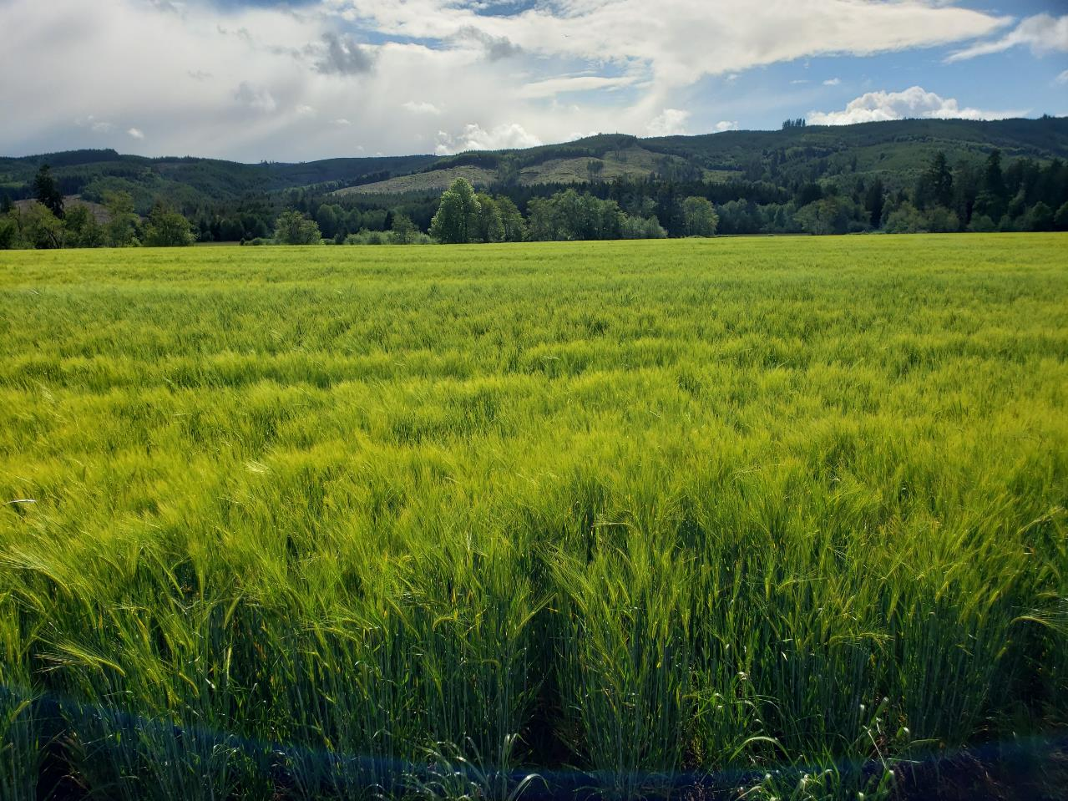
HISTORY
Flood Events
Marketing Challenges
National Frozen Foods
Symons Frozen Foods

Slide 2
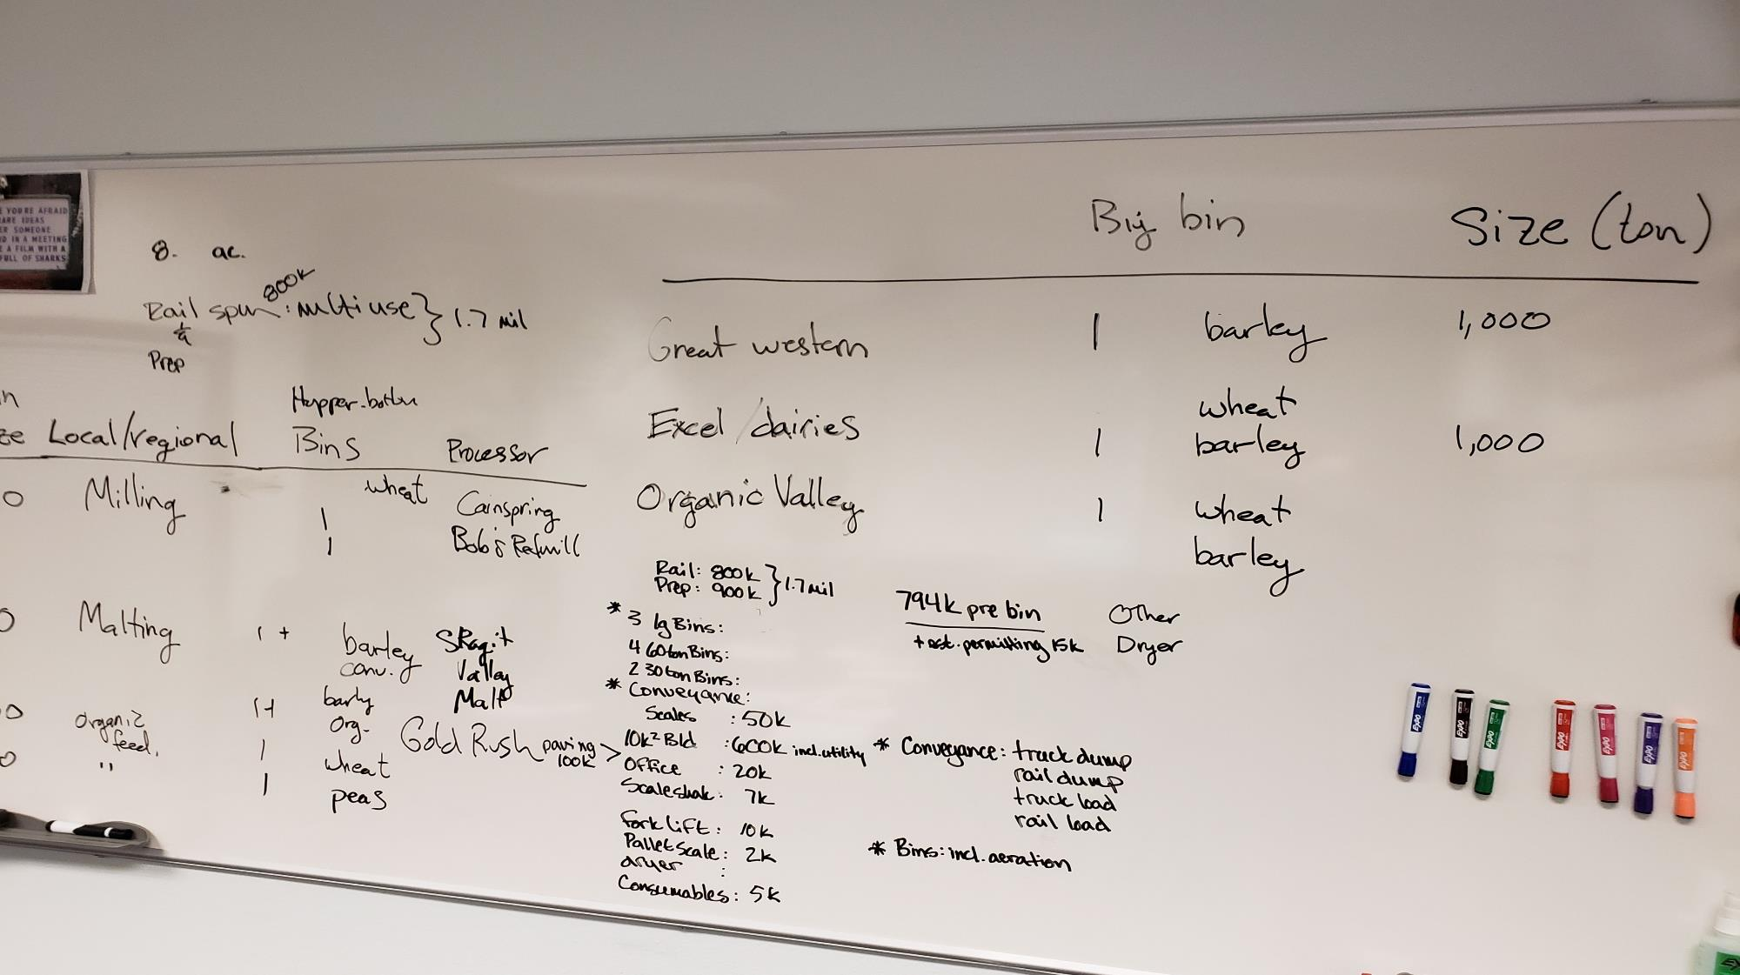

Slide 3
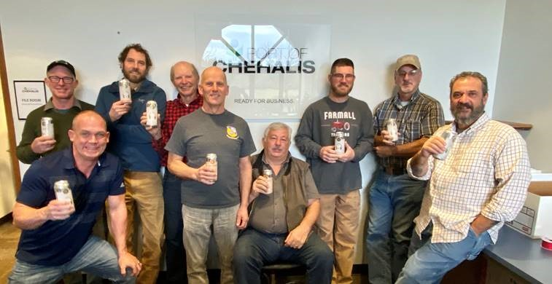
Farmer-Owned Cooperative
Incorporated December 2019
37 members from 6 Counties
Includes SW WA Food Hub
“Increase the viability of Southwest Washington Family Farms through collaborative opportunities
in marketing, logistics, and stewardship.”

Slide 4
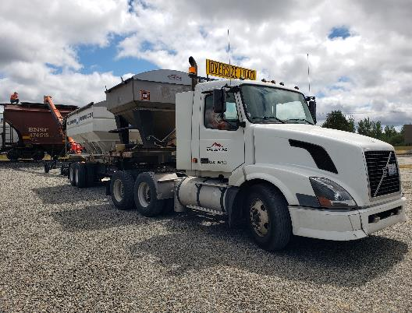
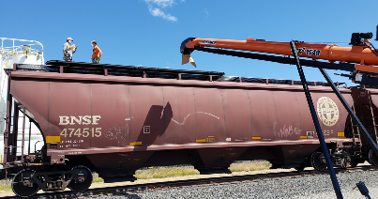
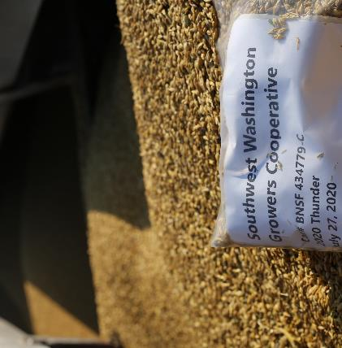
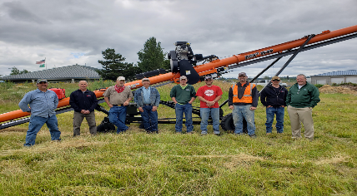
PARTNERSHIP
WSU
OSU
NABC
Great Western Malting
Port of Chehalis
Talking Cedar Brewing
SW WA Growers Co-op
Valley Agronomics

Slide 5
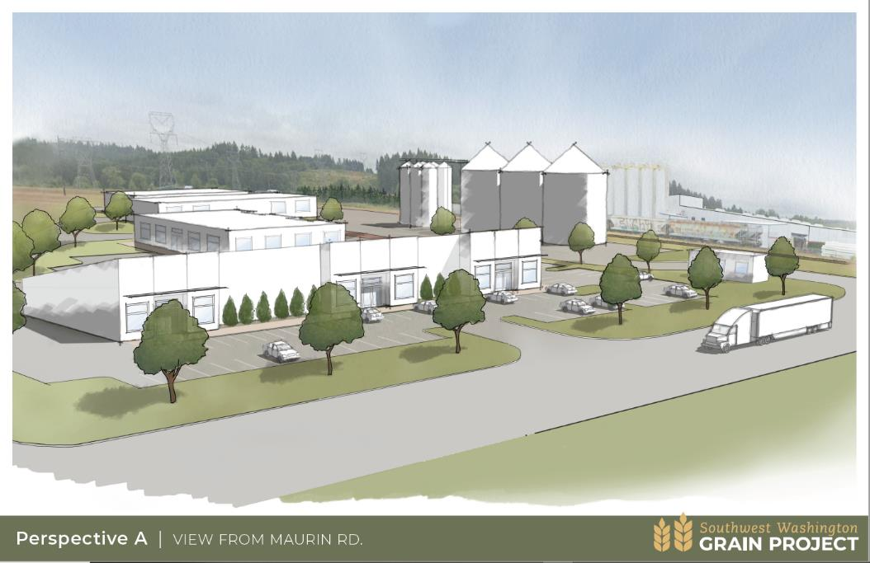
Port of Chehalis Property
$800k Distressed Counties Funds
RBDG Grant for Comprehensive Site Plan: $32k
RBDG for phased construction plan, Geological Survey, and Engineers’ Report: $6.2k
Grain Facility Phase 1 funded through Capital Budget Request
RCDG for continued support: $51k
EDA CARES Grant $4.5M
HUD Funding $4.1M

Slide 9
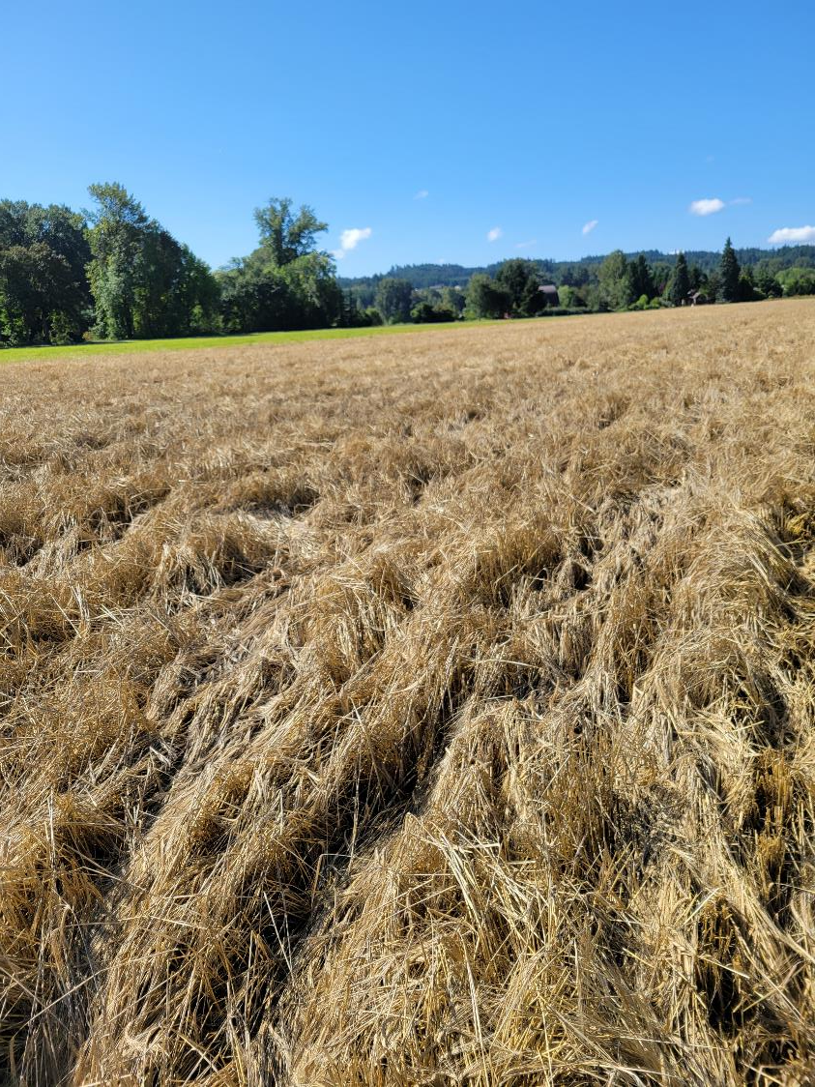
August Rain
Olympia recorded 1.38 inches
Some areas recorded more than 2 inches!

Slide 10
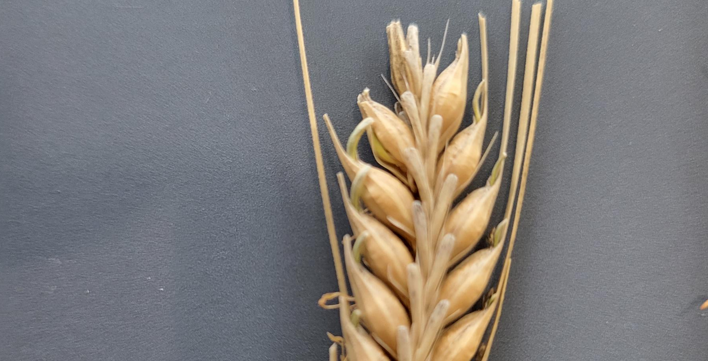

Slide 11
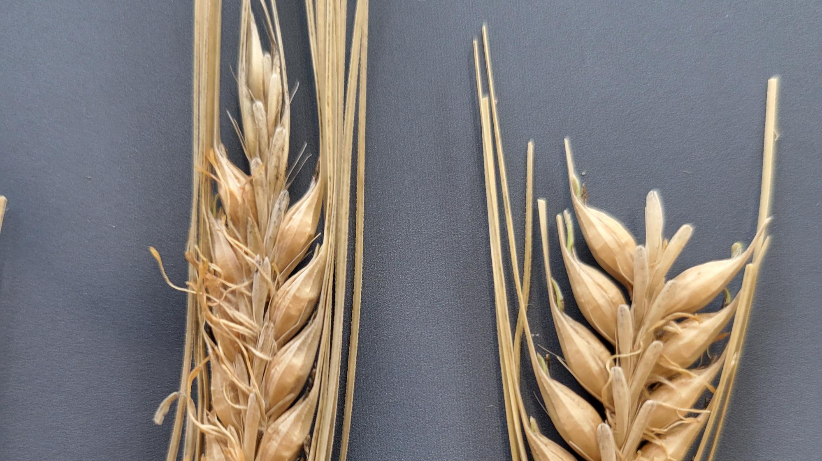

Slide 12
Variety | Acres Planted | Acres Damaged/Lost | Acres Harvested | Revenue Lost | Revenue Recovered?
Connect | 1033 | 858 | 230 | $471,642 | $300K (+) or (-)
Thunder | 235 | 55 | 180 | $39,721 | $0

Slide 14
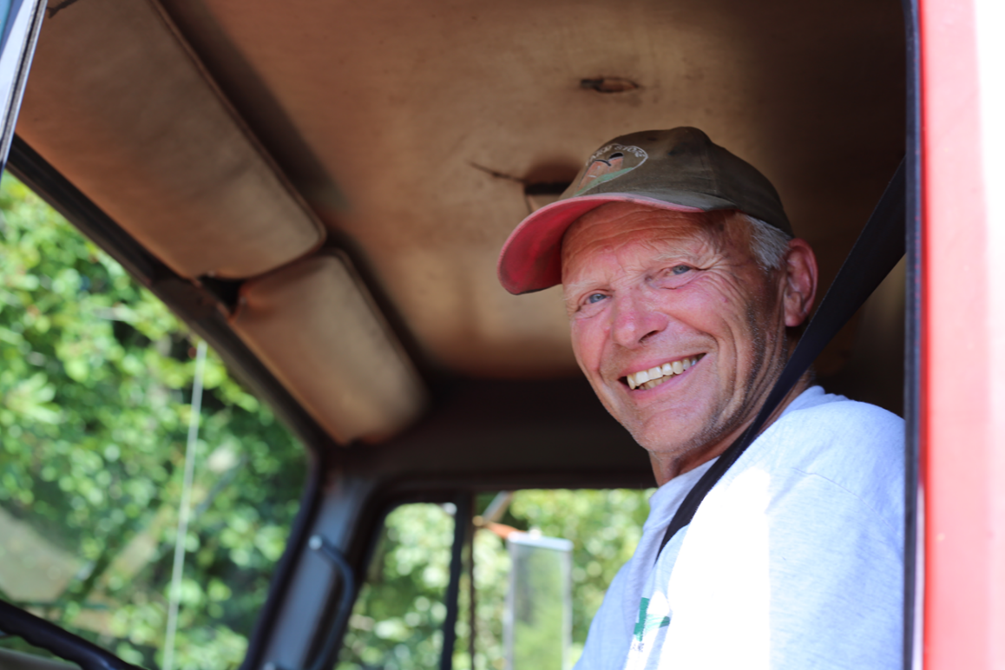
Path Forward Regional Grain
Recent Funding
EDA CARES Grant
Community Funded Projects (HUD)
Source Additional Capital
Membership
Other
Current Markets
Malting Barley
Distilleries
Feed Mills
Seed Crops
Access new markets
Identity preservation
Local brewers/distillers
Additional products

Slide 15
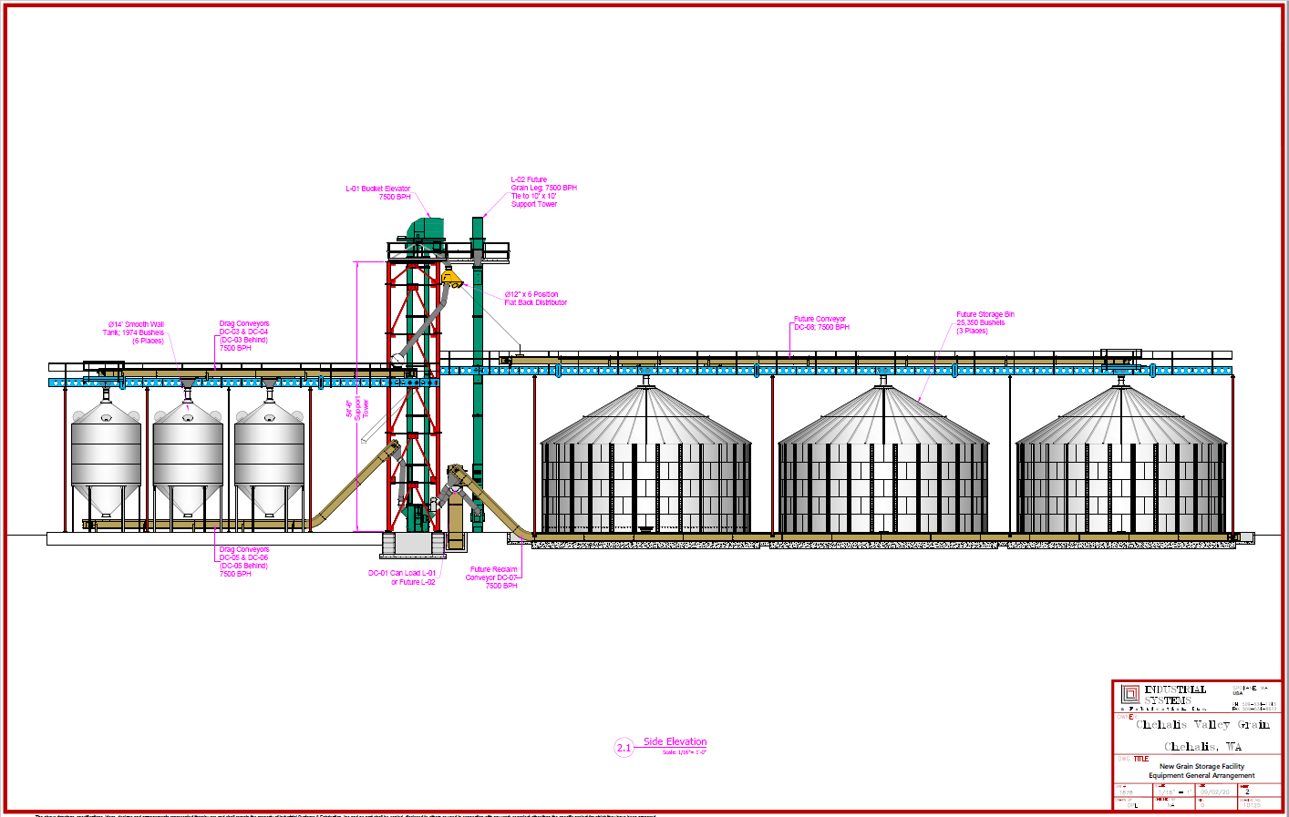
Opportunity
Wheat, barley, oats, peas
Storage & Cleaning
Incoming and outgoing
Access to new markets
Insulation from volatility
Identity preservation
Benefit to: Farmers, Ranchers, Dairy, Poultry, Baking, Brewing, Distilling…

Slide 16
Questions

